Slide 1


Slide 2



ABOUT REDMOND
Who is Redmond?
Started in Redmond, UT and remained local ever since.
We began with a salt mine 67 years ago and it has grown to 10 different brands in many different fields.
We developed Re-Lyte to elevate living for all people
we are all about elevating the human experience in any way we possibly can.

Slide 3
WHY ELECTROLYTES?
Importance of Salt & Electrolytes
Electrolytes hold water
Sodium is the most effective electrolyte
How does sweat affect athletes?
Benefits of proper hydration
enhanced endurance
minimal / no cramping
Regulates body temperature
improves focus & Decision making
Speeds up recovery

Slide 4
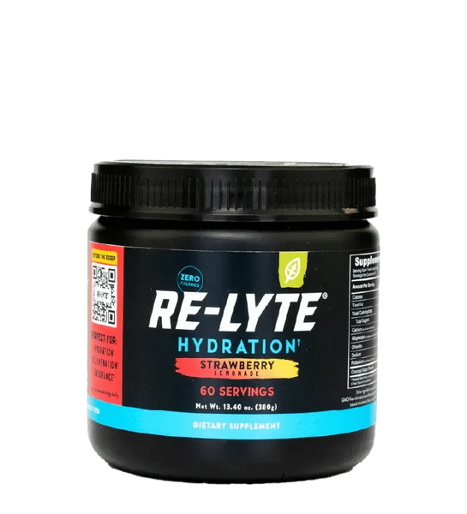
WHAT IS RE-LYTE?
What is Re-Lyte?
Re-Lyte is the future of hydration
Minerals lost in sweat:
Sodium, Chloride, Potassium, Calcium, Magnesium
Salt-based electrolyte drink as opposed to sugar-based competitors
Made with Redmond’s iconic ‘Real salt.’
100% sustainable, Utah-Mined salt. Provides all lost minerals.

Slide 5
FUNDRAISER
FOUR PRODUCTS AVAILABLE
Redmond RE-LYTE HYDRATION TUBS
REDMOND RE-LYTE HYDRATION VARIETY PACK
REDMOND RE-LYTE KID'S HYDRATION
REDMOND REAL SALTSHAKER + RE-LYTE SEVEN-COUNT VARIETY PACK
PRODUCTS WILL BE SOLD AT FULL PRICE.
33% OF SALES WILL BE GIVEN TO THE PLAYER THAT SELLS THE PRODUCT.
THESE FUNDS CAN BE APPLIED TO TEAM FEES LIKE COACHES, TRAVEL, TOURNAMENTS, ETC.
End date TBD

Slide 6
FUNDRAISER- HOW TO
STEPS
ATHLETE Receives ORDER FORM & SELLS PRODUCT TO SOMEONE
WHILE TAKING THE ORDER
COLLECT NECCECARY INFO TO DELIVER PRODUCT
FILL OUT GOOGLE FORM
COLLECT CASH, CHECK, VENMO
3. PRODUCT WILL BE ORDERED BY TEAMS AFTER END DATE
4. PRODUCT WILL BE DELIVERED TO HVU
5. ATHLETES PICK UP AND DELIVER PRODUCT

Slide 7
ONLINE & INCENTIVES
Online Sales
Any out-of-state orders can be placed with the following code at checkout at the Redmond life online website
Code:
All sales will = 30% margin instead of 33%
Incentives
Top 3 sellers will get $250 to adidas
Top team will get a tour of Redmond mine
All players will save money!
citysc

